Slide 1


House Sales in King County, Washington, USA
Linear Regression Exploration
Joey Husney,
Ali Mahzoon

Slide 2

Outline
Overview
About the Process
Data cleaning and Explore Data
Features used for predictions
Prediction Analysis
Business Recommendations
Future Work

Slide 3
Overview
As real-estate agents, we will use this model to project prices and recommend how our selling customers should increase the value of their home
Use this data to give suggestions to buying customers to purchase a home within their budget
For this analysis, we are leveraging data from the house sales in king county
Includes over 20,000 houses sold in 2014 or 2015 for anywhere between $78K and $7.7MM

Slide 4
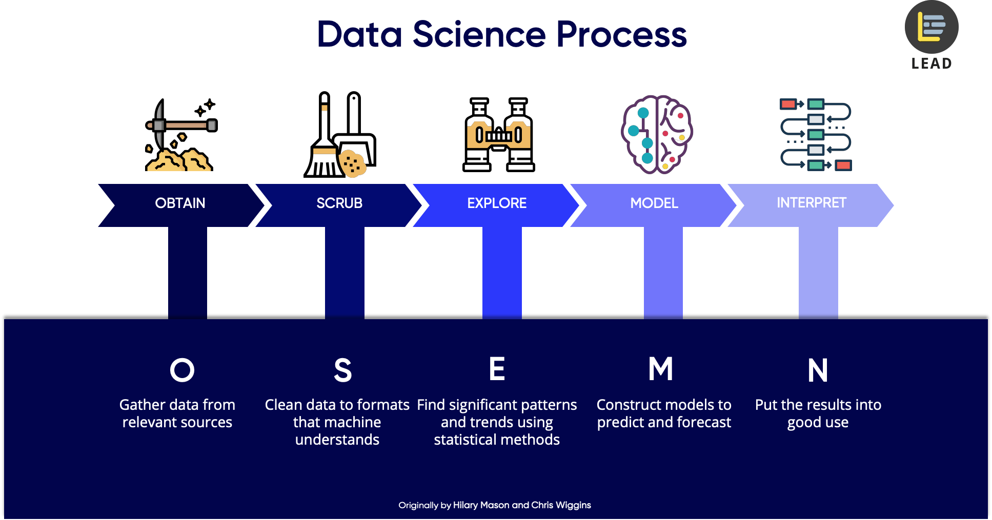
About the Process

Slide 5
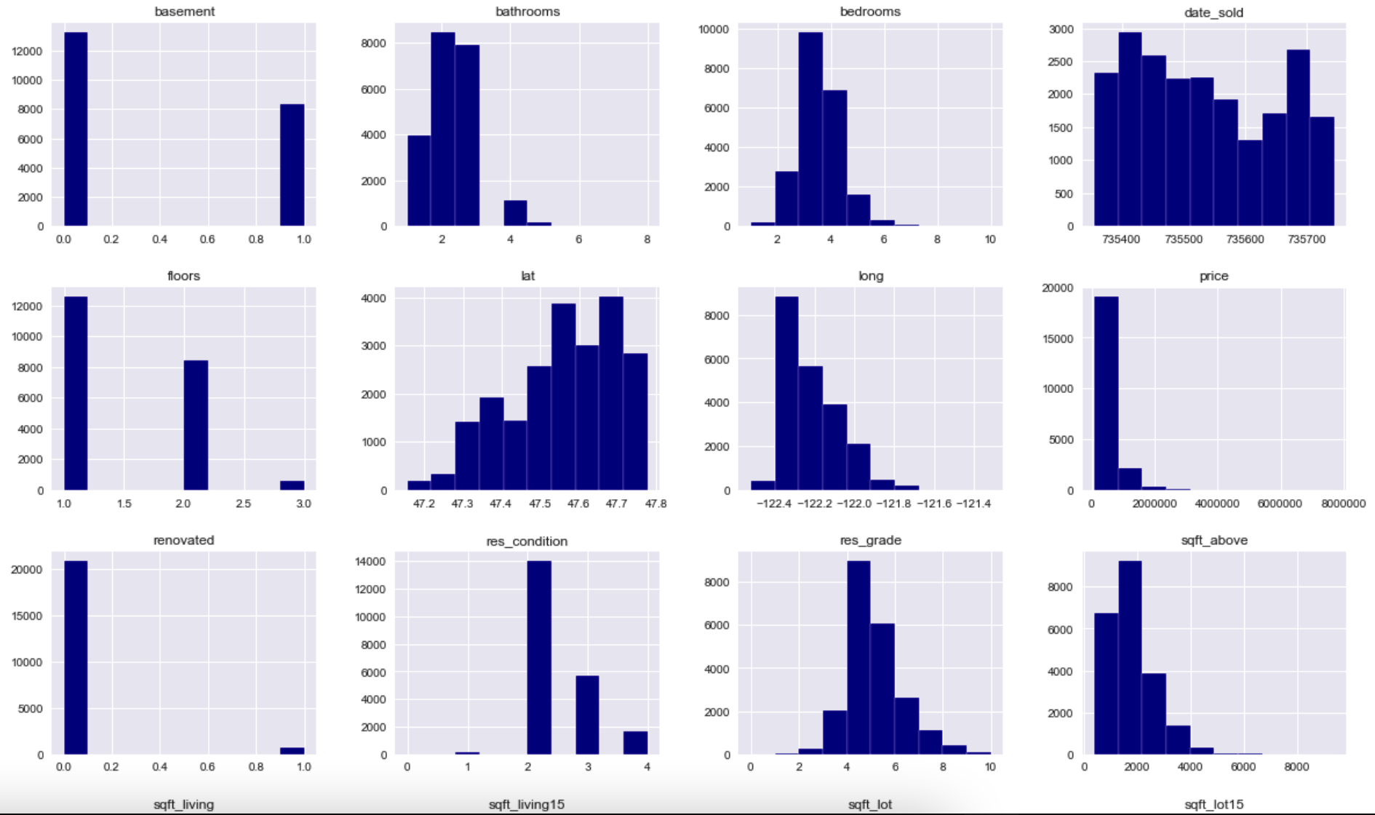
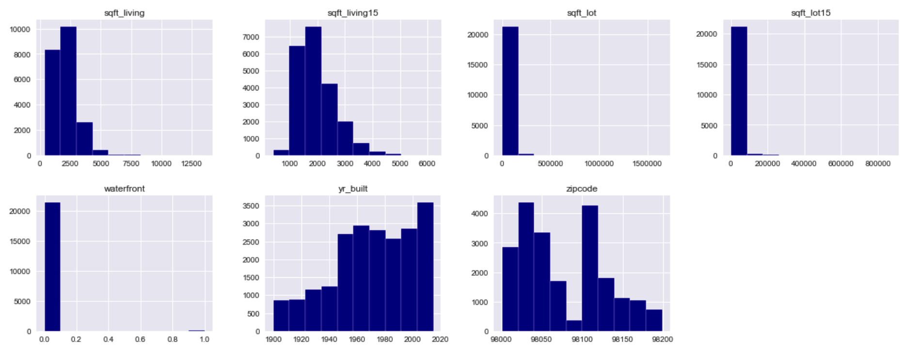
Data Distribution

Slide 6
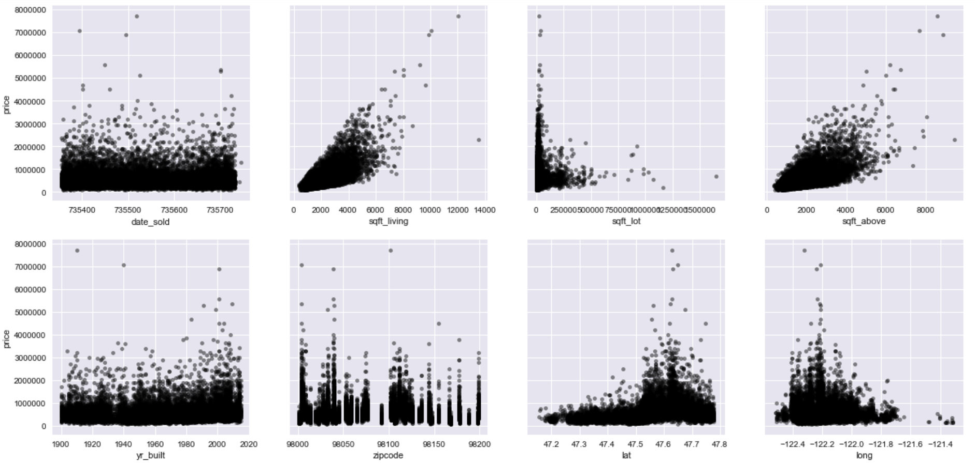
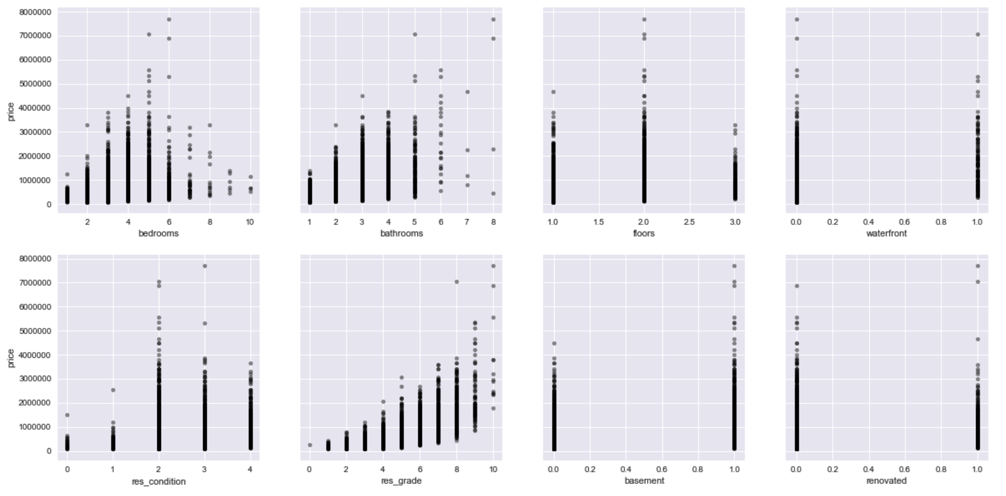
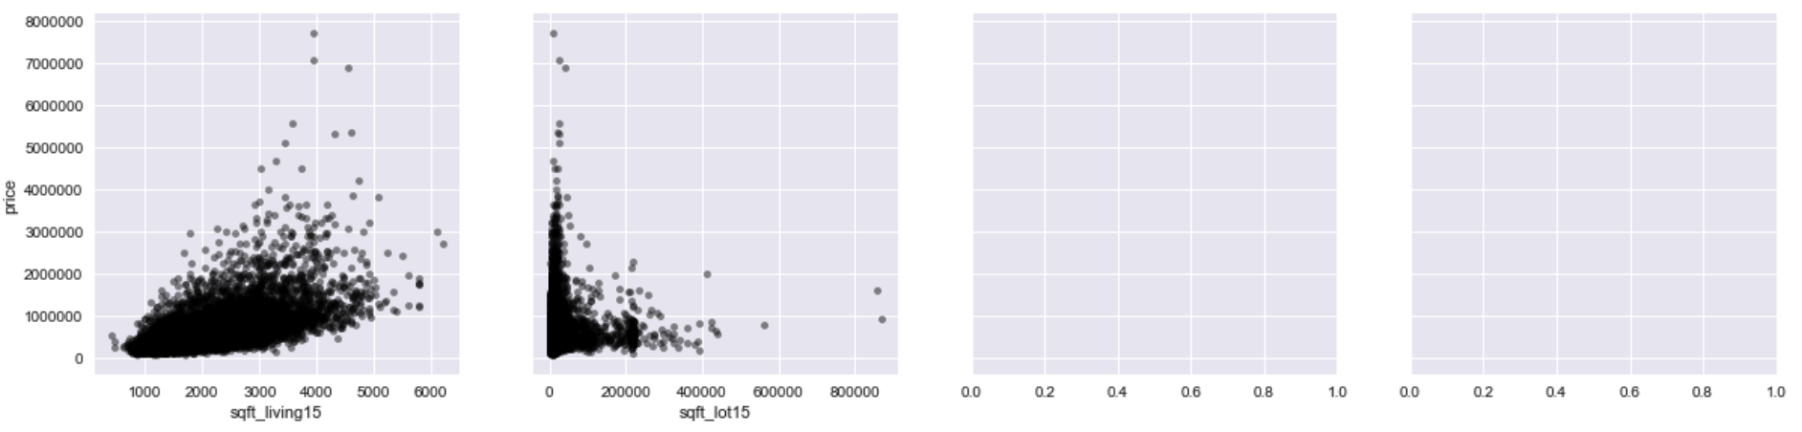
Scatter plots: compare all the predictors with price

Slide 7
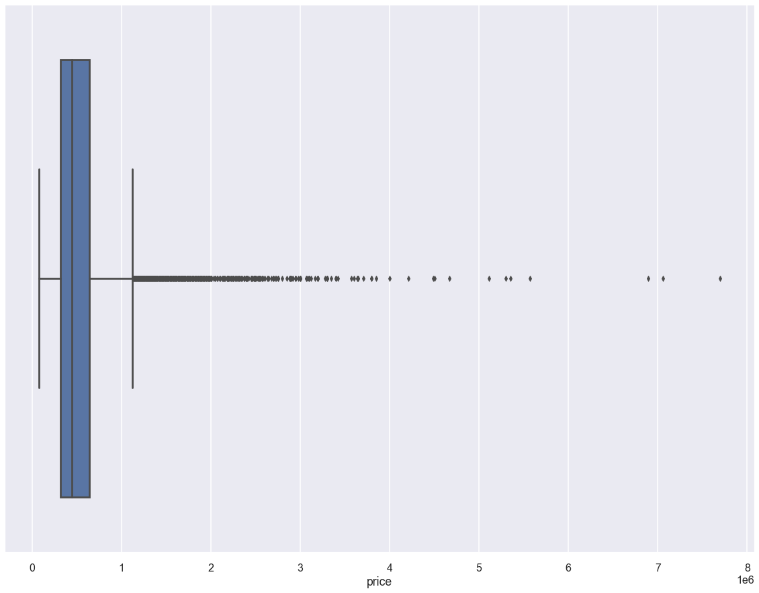
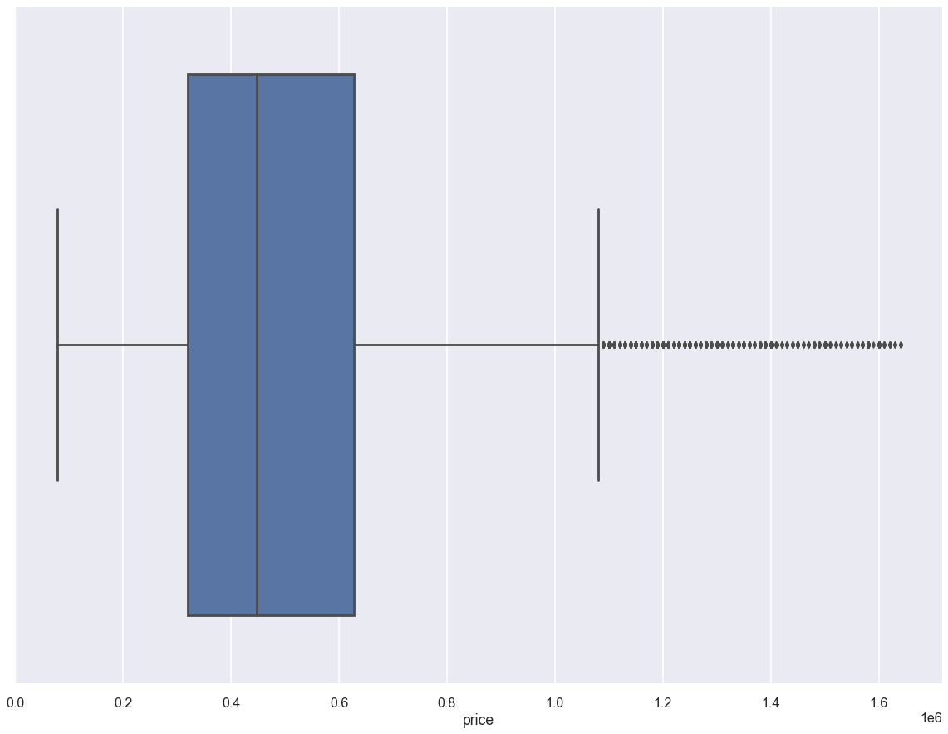
Data cleaning- Outlier removal

Slide 8
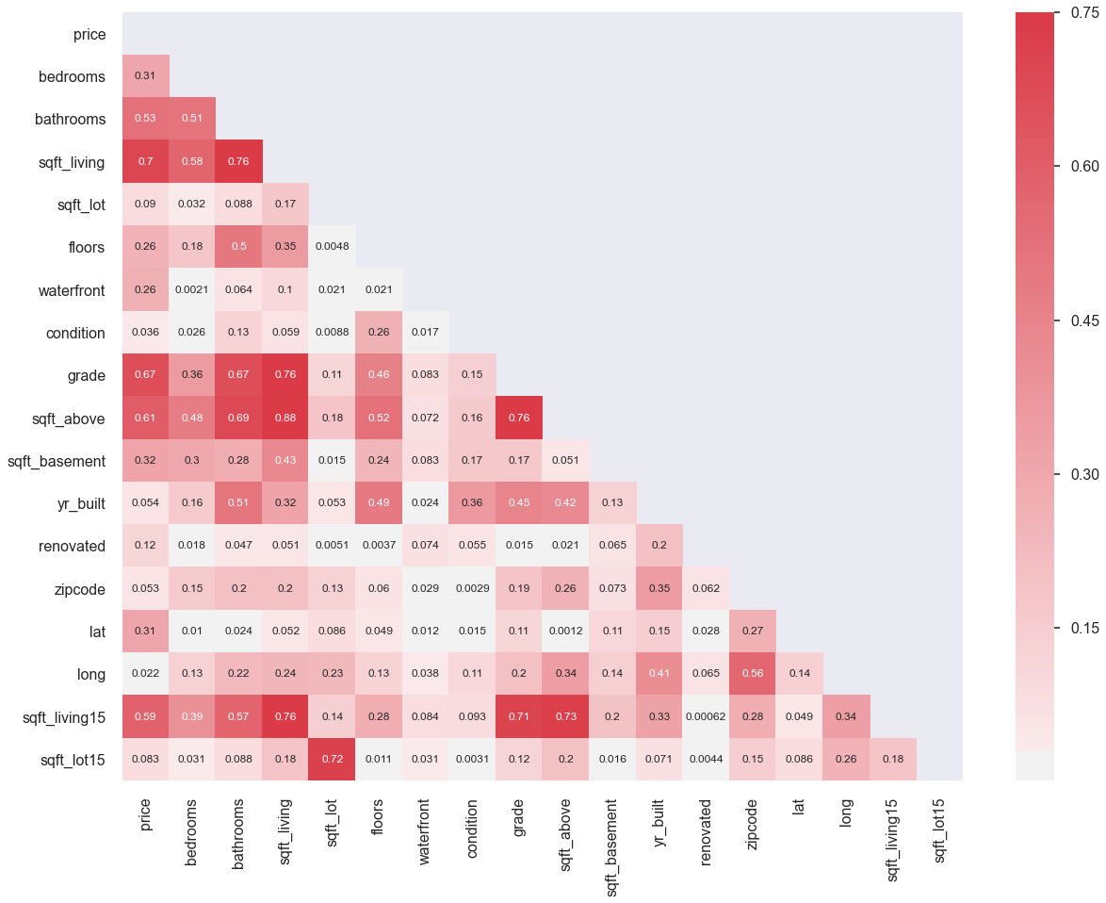
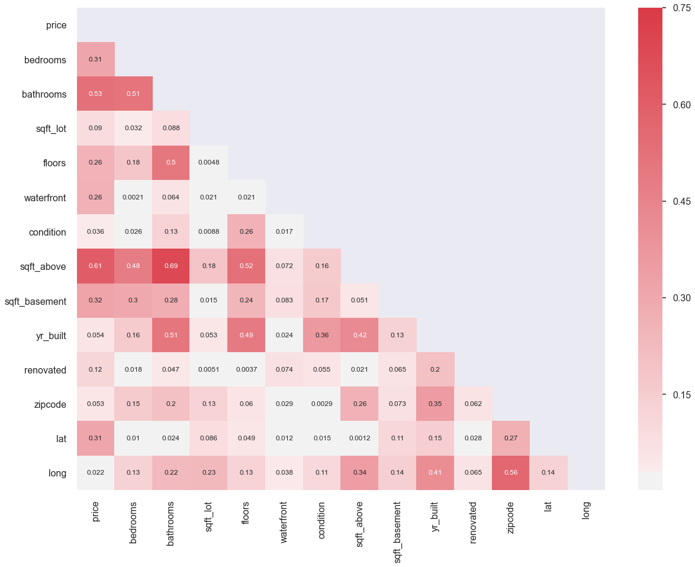
Data cleaning- Removing Multicollinearity (Notice the lighter shade of red due to less columns that relate to each other)

Slide 9
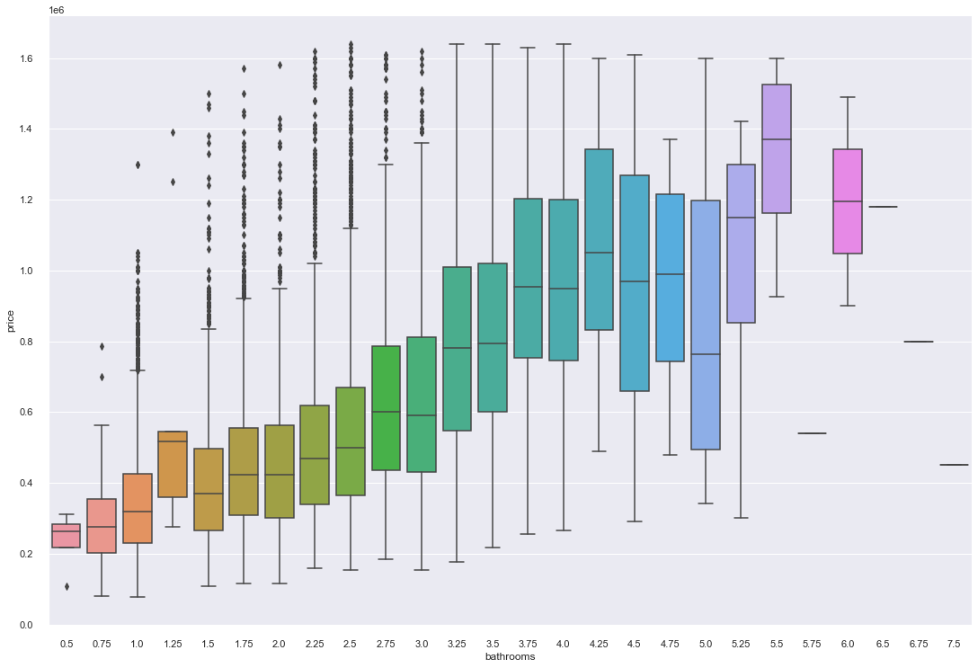
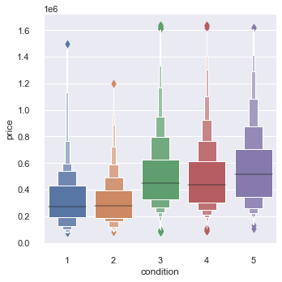
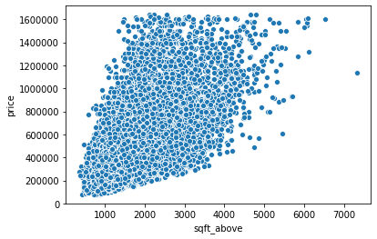
Home sale predictors
Number of Bathrooms highly correlated with sale price
As sqft_above increases, the sale price tends to increase
The condition is something that will increase the sale price

Slide 10
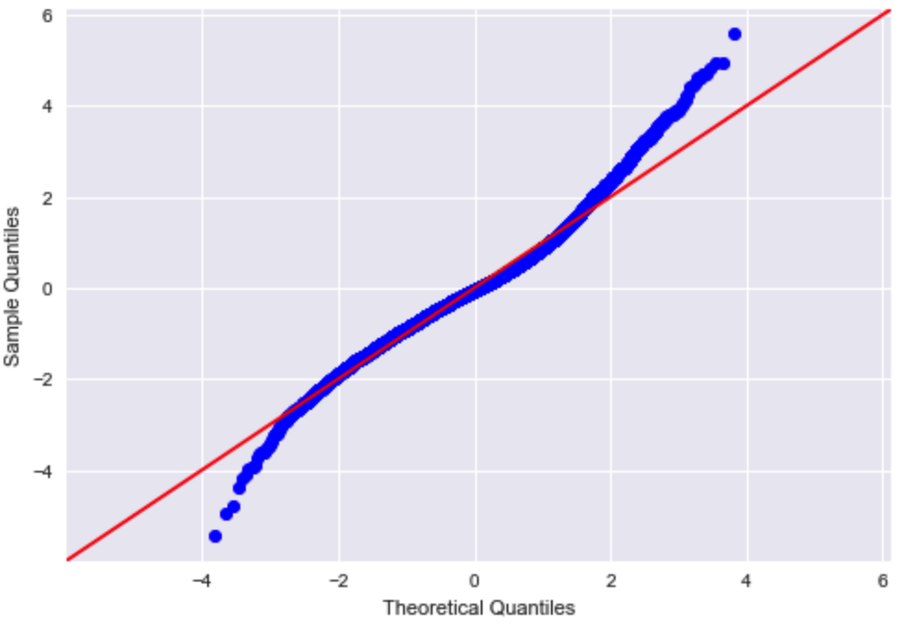
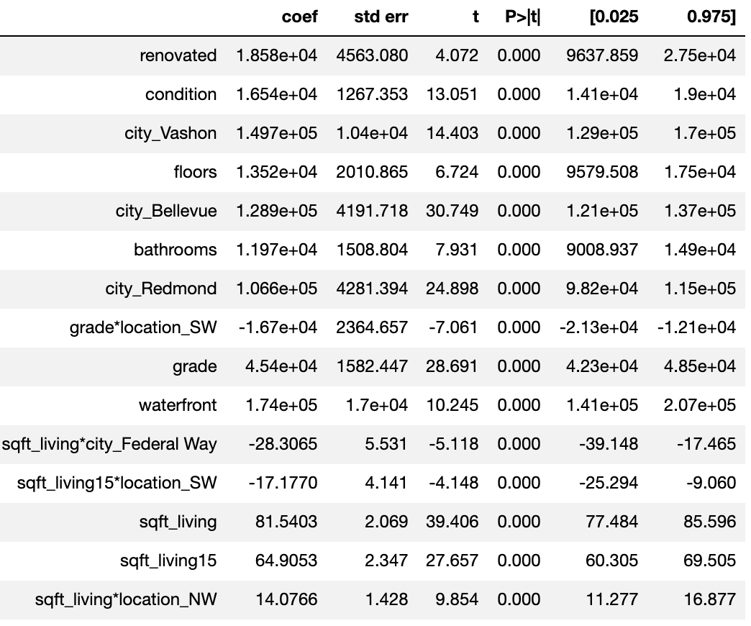
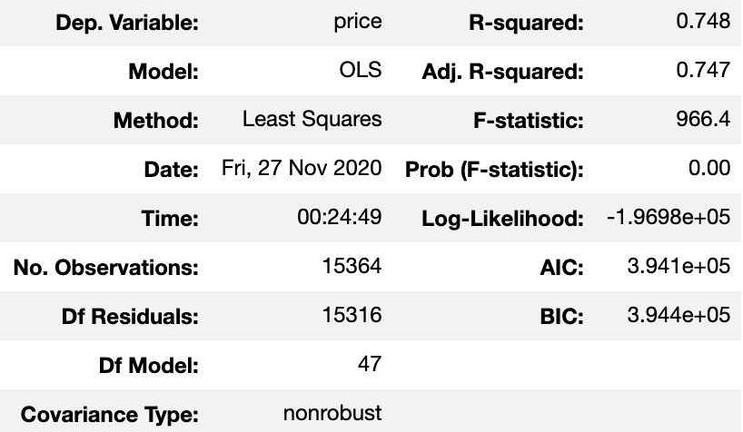
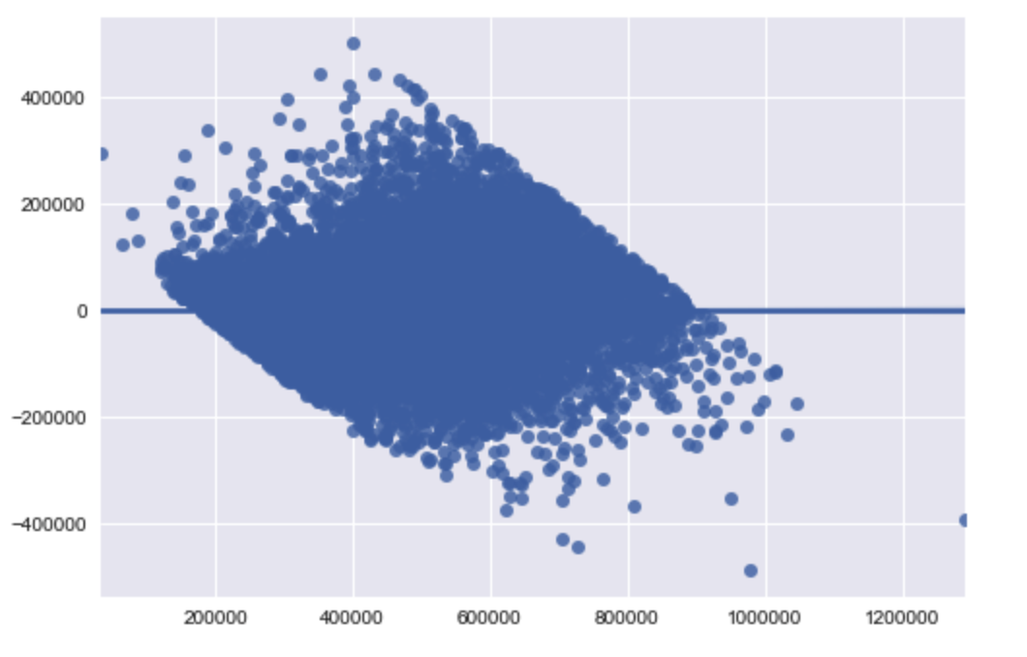
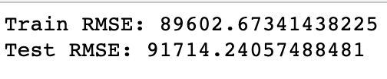
Final Model
Q-Q Plots
Top 15 Coefficients
R-squared
Homoscedasticity

Slide 11
Business Recommendations
Increase home square footage as much as possible
Home should be in very good condition
Increase number of bathrooms in home

Slide 12
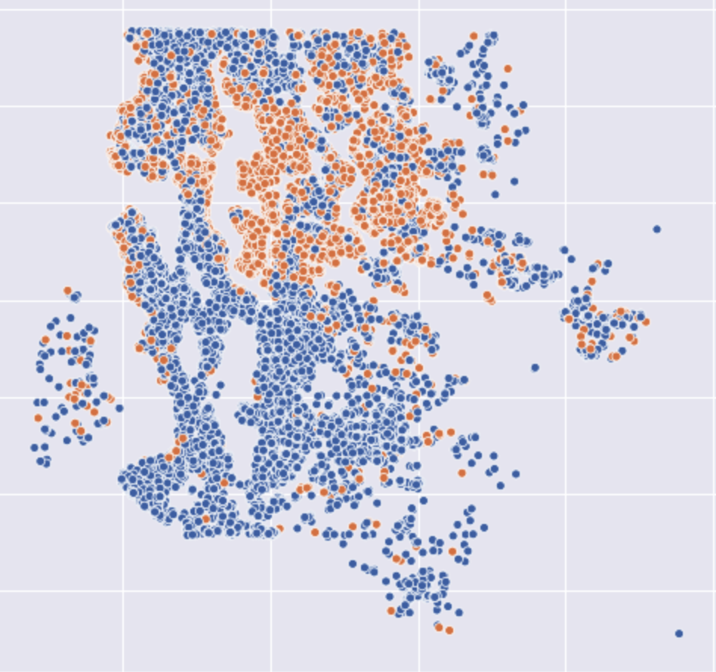
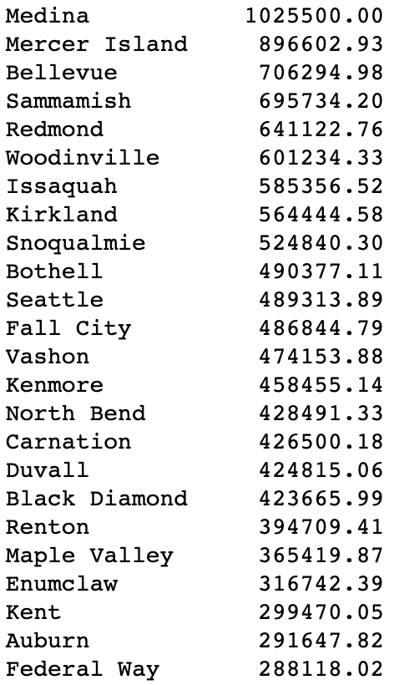
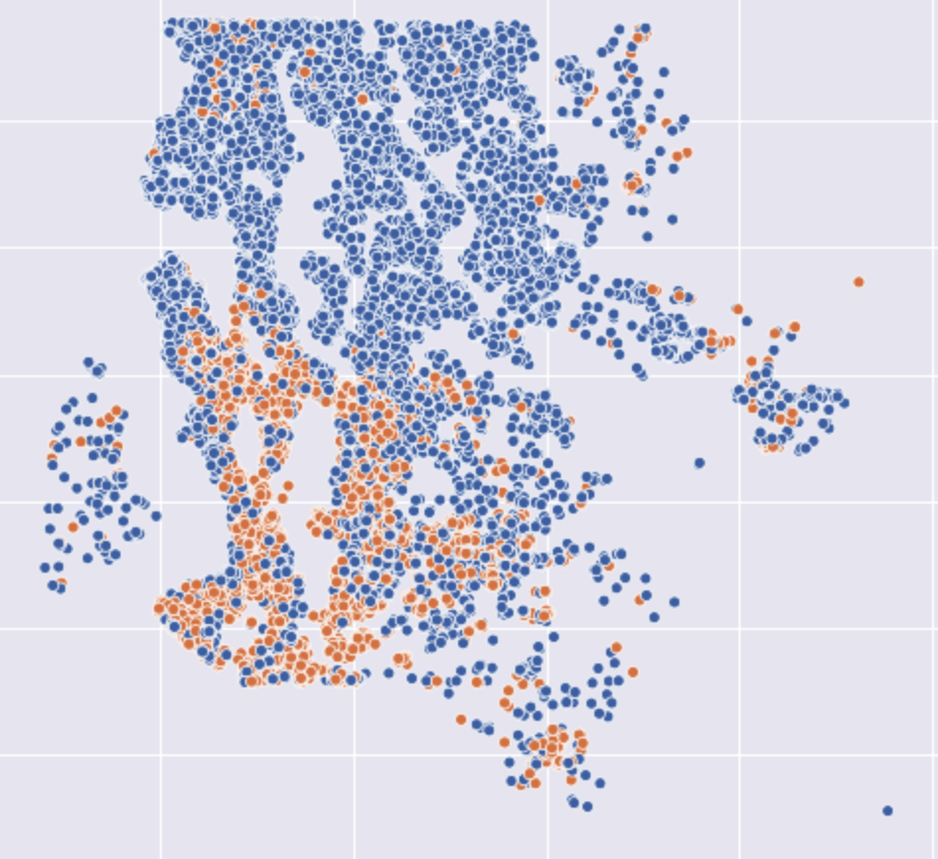
Business Recommendation
Orange dots are showing prices more than 617,000$
Orange dots are showing prices less than 300,000$
Recommend house prices by average prices in each city and their location on the map

Slide 13
Future Work
Analyze different areas and see if the same ideas come to mind
Split the data and create different models with different price ranges
Analyze prices based on area population density

Slide 14
Thank you for listening!

